Slide 1
Rendering – Raytracing
CSE 3541/5541
Matt Boggus

Slide 2
Overview
Ray tracing basic concepts
PPM image file format
Ray generation and collision
Lighting and shading
Recursive ray generation

Slide 3
Ray tracing algorithm
Image plane
Eye
Loop over all pixels
Shoot ray through each pixel
Determine the color of the object at the point of intersection
Notes:
Figures modified from Rick Parent’s 681 slides:
http://web.cse.ohio-state.edu/~parent.1/classes/681/WI11/schedule.html

Slide 4
Lab 6 introduction

Slide 5
Recursive rays
Image plane
Eye
Notes:
Figures modified from Rick Parent’s 681 slides:
http://web.cse.ohio-state.edu/~parent.1/classes/681/WI11/schedule.html

Slide 6
Image output

Slide 7
PPM image format
One of the simplest formats
Image format and color values written using ASCII characters
Allows whitespace for human readability
Limited color range and inefficient storage compared to other image file types

Slide 8
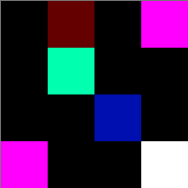
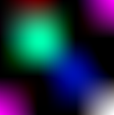
PPM file format and example
P3
width height
maximum color value
A raster of height rows
More formal description of file contents here
Example file:
P3
4 4
255
0 0 0 100 0 0 0 0 0 255 0 255
0 0 0 0 255 175 0 0 0 0 0 0
0 0 0 0 0 0 0 15 175 0 0 0
255 0 255 0 0 0 0 0 0 255 255 255
Image as uniformly scaled up
Image as drawn and zoomed in on within IrfanView
Notes:
Sample image from: https://www.cs.swarthmore.edu/~soni/cs35/f13/Labs/extras/01/ppm_info.html

Slide 9
Algorithm to output ppm image file
Suppose Vector3 colorGrid[n,m] exists
Print “P3”
Print colorGrid’s width
Print colorGrid’s height
Print max value in colorGrid (this should just be a constant)
Loop over colorGrid rows, printing x, y, z values for each Vector3 in the row (white space must follow each color value)

Slide 10
Reference materials on file output within Unity scripts
File component is for binary files, not plaintext
StreamWriter (.NET documentation)
JavaScript and C# code samples using StreamWriter (link)

Slide 11
Generating the initial rays

Slide 12
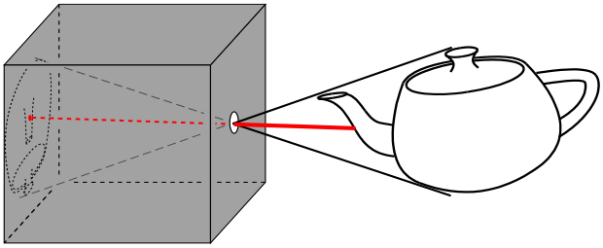
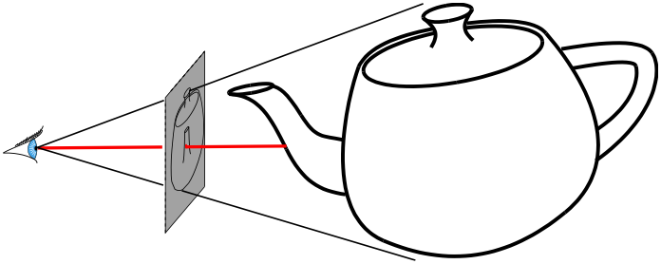
Pin-hole camera model
pin-hole camera
simplified pin-hole camera
Notes:
Figures modified from Rick Parent’s 681 slides:
http://web.cse.ohio-state.edu/~parent.1/classes/681/WI11/schedule.html

Slide 13
Pin-hole camera model
pin-hole camera
Camera’s forward and up vectors
simplified pin-hole camera
Notes:
Figures modified from Rick Parent’s 681 slides:
http://web.cse.ohio-state.edu/~parent.1/classes/681/WI11/schedule.html

Slide 14
Defining the image frame
Width ; number of columns
Height ; number of rows

Slide 15
Defining the image frame
camera
r(t)
p [ a point in the image plane ]
t=0
p [center of image frame] = camera.position + camera.forward * distanceToImageFrame
4 adjacent pixels: p + dx * camera.right ; p – dx * camera.right ;
p + dy * camera.up ; p – dy * camera.up

Slide 16
Ray construction – perspective and orthographic projects
Boardwork examples

Slide 17
Ray intersection testing in Unity
Physics.Raycast
Video tutorial
Raycast rendering algorithm:
Foreach ray r corresponding to one pixel[x,y] in image frame
if(r hit nothing)
pixel[x,y] = background color
else(r hit object o)
pixel[x,y] = color of object o at point of intersection with r

Slide 18
Lighting and Shading calculations

Slide 19
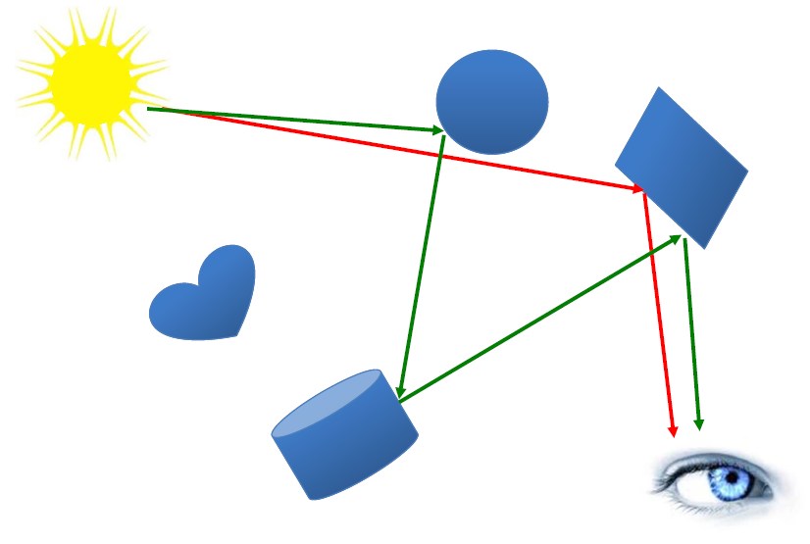
Physics of light
Red lines – single bounce ; local illumination
Green lines – multiple bounce ; global illumination

Slide 20
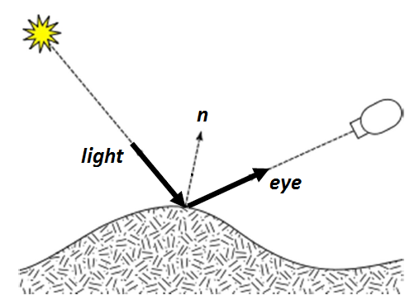
Vectors for light modeling

Slide 21
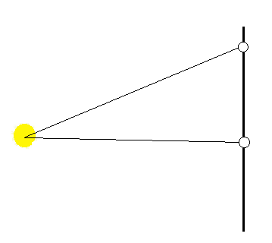
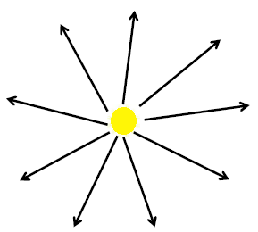
Point light
Emit light in all directions
Vector from point to light

Slide 22
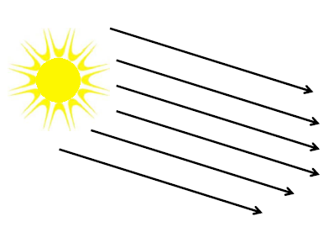
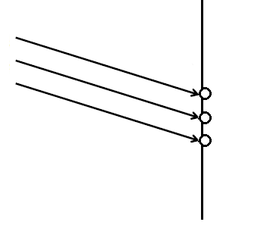
Directional light
Light vector always the same

Slide 23
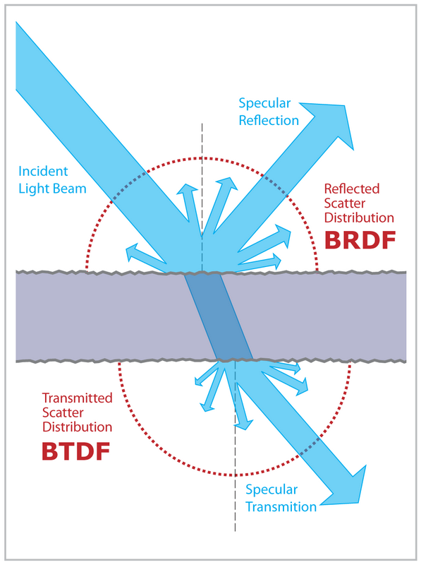
Light scattering on a surface
Figure from http://en.wikipedia.org/wiki/Bidirectional_scattering_distribution_function

Slide 24
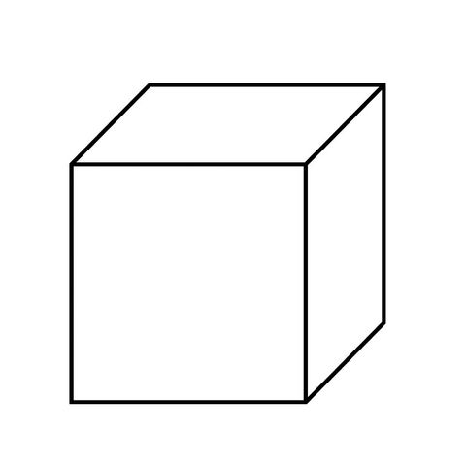
Normals of points on a cube face

Slide 25
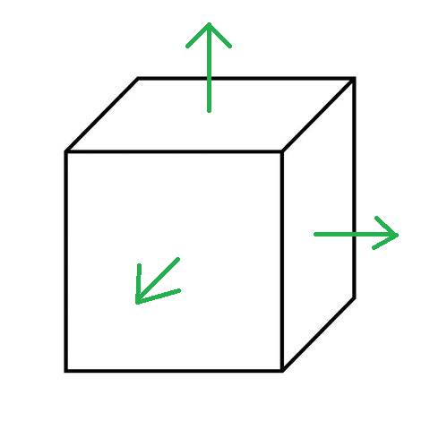
Normals of points on a cube face
Remember: the transform component has vectors for forward, up, and right

Slide 26
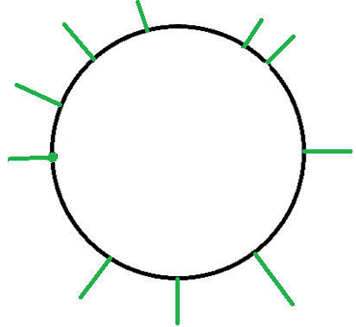
Normals of points on a sphere

Slide 27
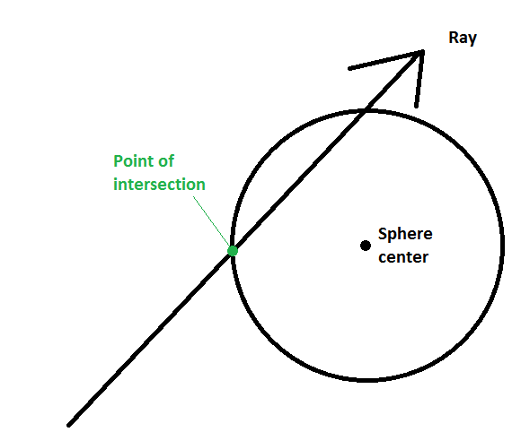
Normal of a point on a sphere

Slide 28
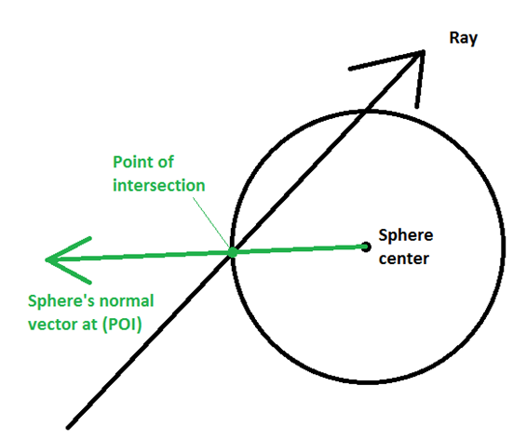
Normal of a point on a sphere

Slide 29
Defining light and material properties
(Red, Green, Blue) values
For a light source, intensity
For the material of an object, reflectivity
Color = intensity * material
Examples:
(1,1,1) white light, (1,1,1) white object ; object appears white
(1,0,0) red light, (1,1,1) white object ; object appears red
(1,1,1) white light, (1,0,0) red object ; object appears red
(1,1,0) yellow light, (0,1,1) cyan object ; object appears green

Slide 30
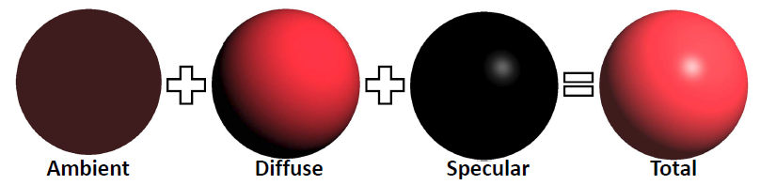
Phong illumination model

Slide 31

Ambient illumination
Approximation for global illumination
L_{ambient} = I_{ambient} * K_{ambient}
[Light = Intensity * Material]
Often I_{ambient} just a constant
Notable exceptions:
Ambient occlusion
Radiant flux

Slide 32
Diffuse illumination
Diffuse reflection assumes that the light is equally reflected in every direction.
In other words, if the light source and the object has fixed positions in the world space, the camera motion doesn’t affect the appearance of the object.
The reflection only depends on the incoming direction. It is independent of the outgoing (viewing) direction.

Slide 33
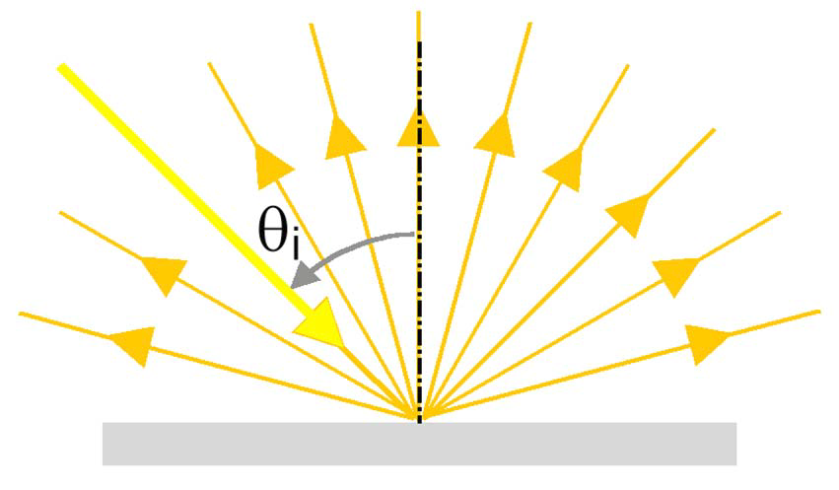
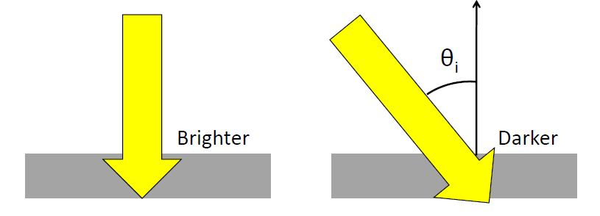
Diffuse illumination
L_{diffuse} = I_{diffuse} * K_{diffuse} * cos θ_{i}

Slide 34
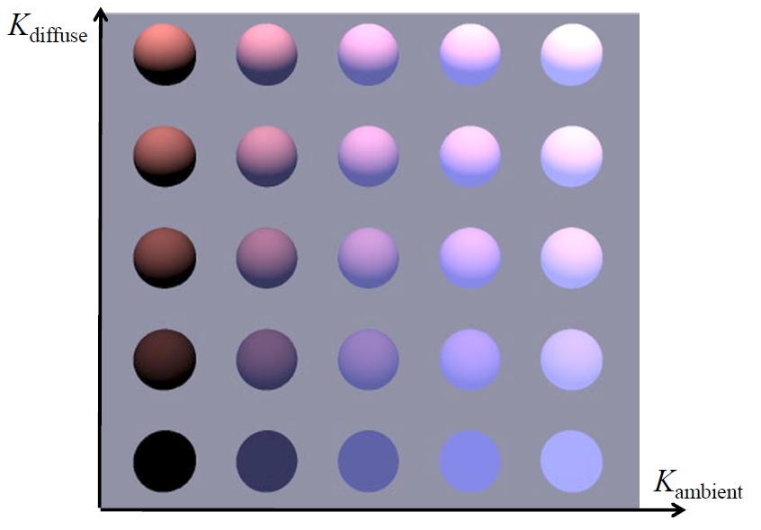
Ambient and Diffuse illumination example

Slide 35
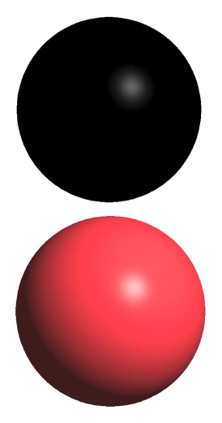
Specular illumination
Some materials, such as plastic and metal, can have shiny highlight spots.
This is due to a glossy mirror-like reflection.
Materials have different shininess/glossiness.

Slide 36
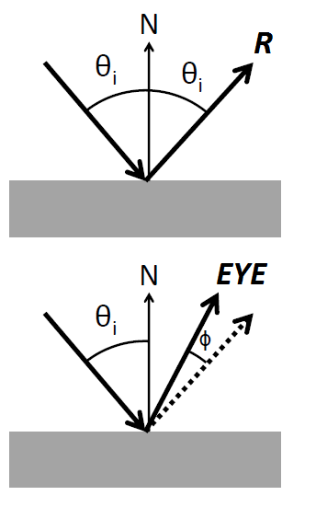
Specular reflection
R = 2(L⋅N)N- L
L_{specular} =
I_{specular} * K_{specular} * cos^{n} φ
n is shininess coefficient
φ is the angle between EYE and R

Slide 37
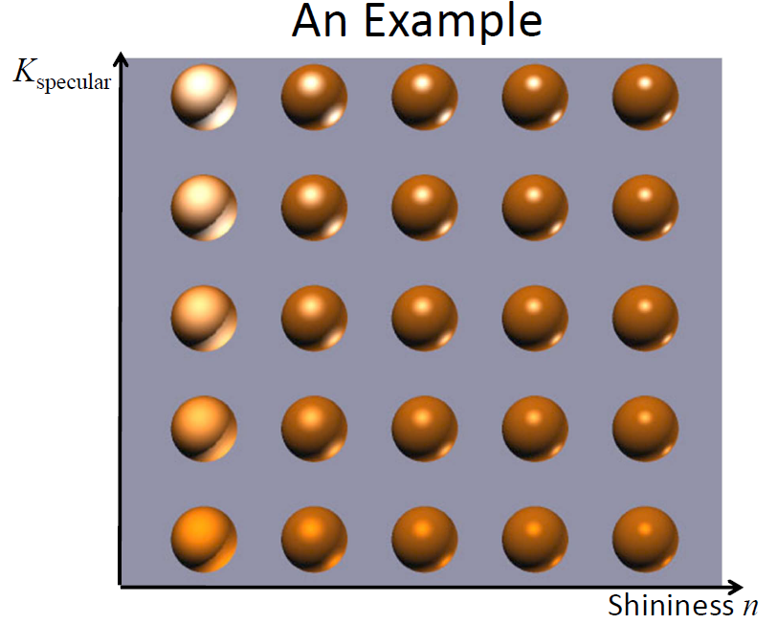
Specular illumination example

Slide 38
Algorithm to ‘color’ a ray
Color shade(R)
{
intersect objects – get closest intersection
c = ambient
For each light source
Add in diffuse and specular components to c
Return c
}

Slide 39
Recursively generated rays

Slide 40
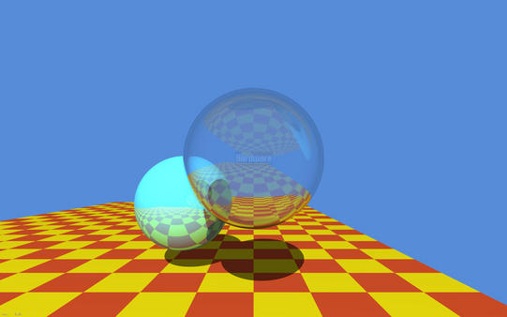
Shadows, reflections, and refractions

Slide 41
Shadows
Determine when light ray is blocked from reaching object
Ray-object intersection calculation
For each pixel
for each object
for each light source
for each object

Slide 42
Shadow algorithm (expands the code iterating over light sources)
For each light source i
If face is backface with respect to light source (determined using normal)
Set IN-SHADOW to TRUE
else
Set IN-SHADOW to FALSE
Construct ray from point to light source
For each object
Test ray-object intersection (between point and l.s.)
If intersection found
Set IN-SHADOW to TRUE for this light source
Break out of object loop
If (NOT IN-SHADOW) add in effect of light source i
accumulate diffuse light
accumulate specular light

Slide 43
Reflection
Image plane
Eye

Slide 44
Reflection algorithm (expands previous ‘coloring’ algorithm)
Color shade(ray,recursionDepth)
{
intersect objects to get point, normal, object
If (intersection) {
c = ambient color
Compute reflective ray, R, based on ray and normal
For each light source
Compute and add in diffuse and specular components to c
If ( (recursionDepth < maxRecursion) && (object is shiny) )
c += object.shininess * shade(R,recursionDepth+1)
}
Else c = backgroundColor;
Return c
}

Slide 45
Transparency & Refraction
Ray changes direction in transition between materials
Material properties give ratio of in/out angles
Details in the additional slides

Slide 46
Additional slides

Slide 47
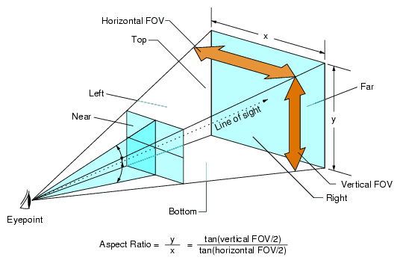
Various parameters for field of view
Notes:
Image source https://pcgamingwiki.com/wiki/Glossary:Field_of_view_(FOV)#/media/File:Fov_diagram.png

Slide 48
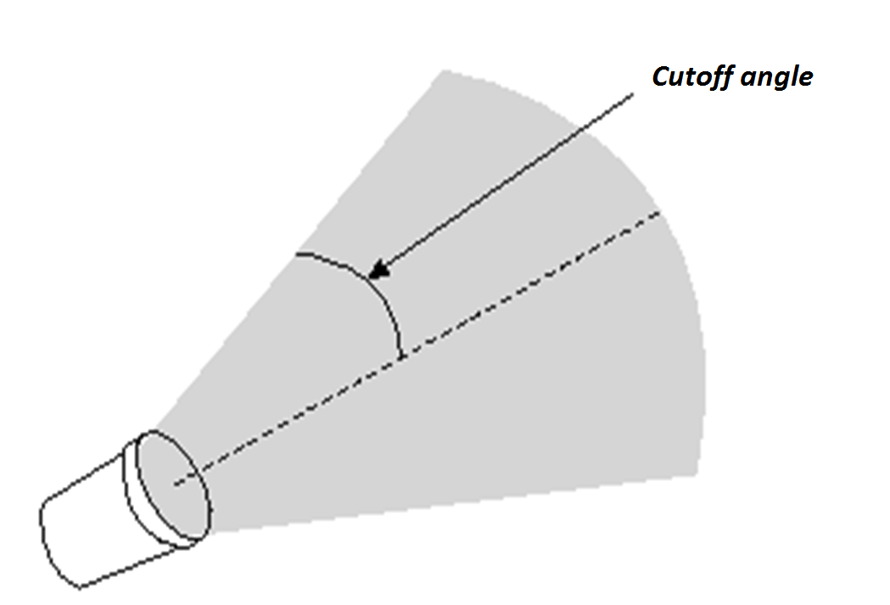
Spotlight

Slide 49
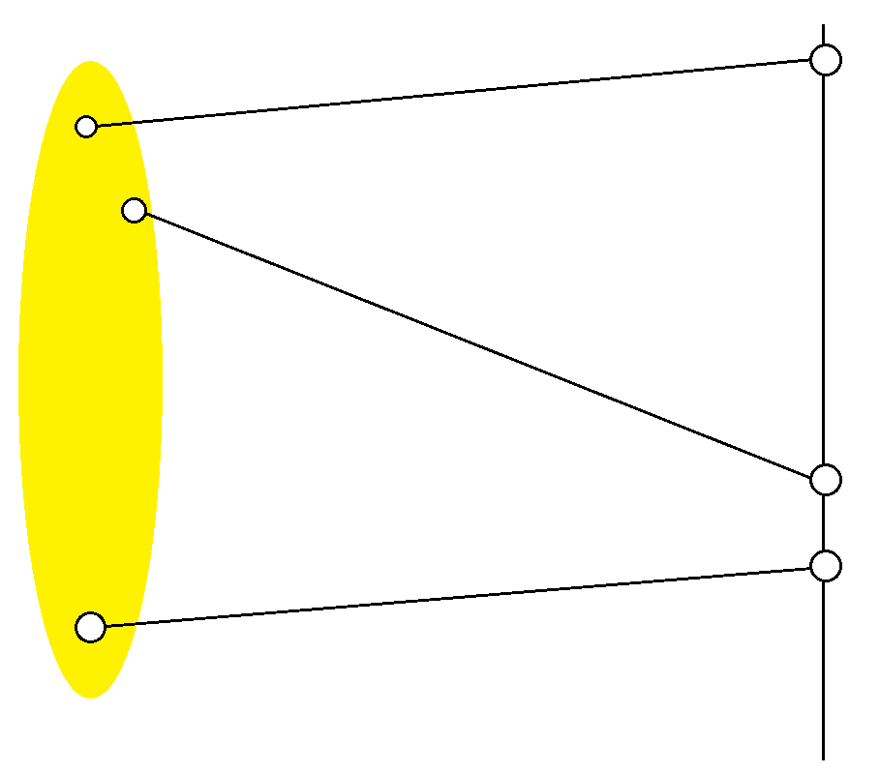
Area light
Requires sampling – pick point on the light then generate the vector from point on the surface to point on the light

Slide 50
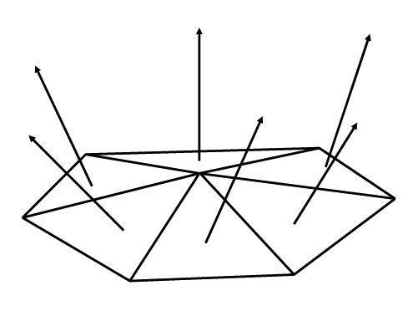
Normal of polygon(s)

Slide 51
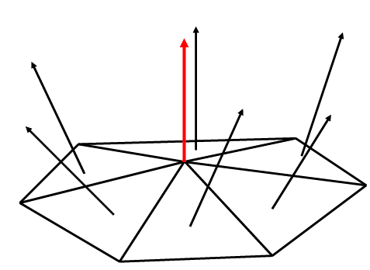
Normal of vertex
Average the normals of the polygons it is used in

Slide 52
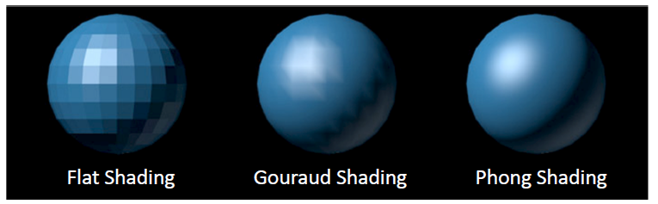
Shading model comparison
Flat shading – one normal per polygon
Gouraud shading – one normal per vertex ; compute color of a point on the polygon by:
computing color at each vertex and linearly interpolate colors inside the polygon
Phong shading – one normal per vertex ; compute color of a point on the polygon by:
linearly interpolate the normal vector, then perform lighting calculation

Slide 53
Optimizations

Slide 54
Sampling and Aliasing
Problem: Representing pixel by a single ray.
Notes:
Using higher resolution won’t solve problem.
No matter how small pixels are, objects can be smaller.

Slide 55
Efficiency
1280 x 1024 = 1,310,720 ≈ 10⁶ pixels.
10⁶ initial rays.
10⁶ reflection rays.
Potentially 10⁶ refraction rays.
3 x 10⁶ shadow rays (3 lights.)
Next level:
Potentially 4 x 10⁶ refraction/reflection rays.
1,000,000 polygons.
10⁷ x 10⁶ = 10¹³ ray-polygon intersection calculations.
Notes:
No anti-aliasing.

Slide 56
Intersection Data Structures
Coarse test to see if a ray could *possibly* intersect object
OR
Divide space up
– sort objects into spatial buckets
– trace ray from bucket to bucket

Slide 57
Bounding Boxes

Slide 58
Spatial Subdivision

Slide 59
Additional / Cut Slides

Slide 60
Refractive Ray Tracing
Same idea as Reflective ray tracing – spawn a secondary ray
The direction of the spawned ray is in the direction of the incoming ray altered a little bit
The alteration is based on the material that the ray is leaving (e.g. air) and the material that the ray is entering (e.g., glass)
Once this direction is computed, then the shade routine is called recursively, just as with reflective rays.

Slide 61
Refractive Ray Tracing
dir
n
q₁
Medium c₁
Medium c₂
T₂
q₂
Snell’s Law

Slide 62
Refractive Ray Direction
dir
cos(q₁) = -dir·n
q₁
n
sin(q₁) = sqrt(1- cos²(q₁))
sin(q₂) = n₁*sin(q₁)/n₂
q₂
cos(q₂) = sqrt(1 - sin²(q₂))
cos(q₂) = sqrt(1 - (n₁*sin(q₁)/n₂)²)
cos(q₂) = sqrt(1 - (n₁/n₂)²* (1- cos²(q₁)))
cos(q₂) = sqrt(1 - (n₁/n₂)²* (1- (dir·n)²)
NOTE: if radical is negative, no refraction!

Slide 63
Refractive Ray Direction
n
Go cos(q₂) in the -n direction
Go sin(q₂) in the orthogonal direction
(while still in the plane of dir and n)
q₁
dir
This direction (scaled by sin(q₁)) is: dir - (dir·n)n
And scaled by sin(q₂) is: (n₁/n₂)(dir-(dir·n)n)
T = (n₁/n₂)dir - (n₁/n₂)(dir·n)n - cos(q₂)n

Slide 64
Recursive Ray Tracing
Color shade(ray,recursionDepth)
{
intersect objects…
compute R …
Process each light source …
If (recursionDepth < maxRecursion) {
If (object is shiny) c += shininess * shade(R, recursionDepth+1)
If (object is transmittive) {
Compute refractive ray, T, based on ray, normal, and Snell constants
c = (1-transmittive)*c + transmittive * shade(T, recursionDepth+1)
}
}
Return c
}

Slide 65
Refractive Intersection Normal

Slide 66
Recursive Ray Tracing
ray
n
R1
T1
R2
T2
T3
R3

Slide 67
Reflectivity varies with incident angle
NOTE: refraction is really wavelength dependent (where rainbows come from).
Fresnel equations
Schlick approximation:
R0 is reflectance at normal incidence:

